Slide 1



Emotion in Every Utterance
ARUN J
TKM22MCA-2011
PROJECT GUIDE :
DR FOUSIA M SHAMSUDEEN

Slide 2
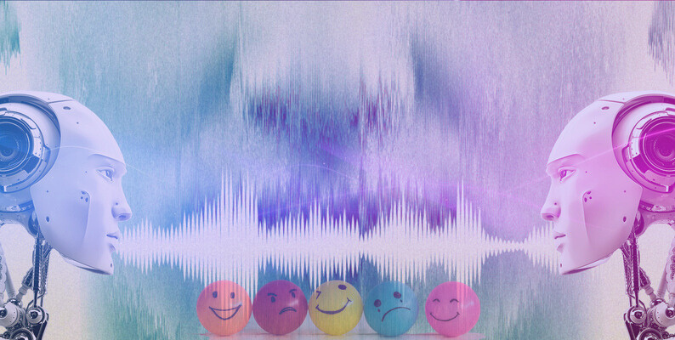
Agenda
01. Introduction
02. Related Works
03. Gaps Identified
04. Problem Statement
05. Objective
06. Methodology
07. Identifying Dataset
08. Result
09. Conclusion

Slide 3


01
INTRODUCTION
Emotion recognition is quite a challenging task, but emotions are not constant.

Slide 4
Introduction
A speech emotion recognition(SER)system is a collection of methodologies that process and classify speech signals to detect emotions embedded in them.
These SER systems can be used in a wide variety of application areas like an interactive voice-based assistant or caller-agent conversation analysis.
With the help of this project, professionals can leverage machine learning to obtain the underlying emotion from speech audio data and some insights into the human expression of emotion through voice.

Slide 5
02
Related Works

Slide 6
RELATED WORKS
SI NO | Title of Paper, Journal name, Publisher, year | PROS OF THE PAPER | CONS OF THE PAPER
1 | Speech emotion recognition based on emotion perception, EURASIP Journal on Audio Speech, and Music Processing, Gang Liu1- , Springer Open, 2023. | Incorporation of Human Perception: By drawing inspiration from human emotional perception processes, this approach attempts to align SER more closely with how humans recognize emotions, potentially leading to more accurate results. Implicit Emotional Attributes: The introduction of implicit emotional attributes through multi-task learning could help capture subtle emotional nuances that might be missed by traditional SER methods. Performance Improvement: Preliminary experiments on the IEMOCAP dataset indicate a notable increase in accuracy, with the unweighted accuracy (UA) and weighted accuracy (WA) showing substantial improvements. This suggests the potential effectiveness of the proposed method in improving SER performance. | Complexity: Incorporating principles from brain science and emotional perception may introduce a level of complexity that could be challenging to implement, particularly for those without expertise in these areas. Computational Intensity: Deep learning models, especially those inspired by brain science and involving multi-task learning, can be computationally intensive and may require substantial resources for training and deployment. Generalization:The effectiveness of this approach on the IEMOCAP dataset needs to be validated on a broader range of datasets to ensure that it can generalize well across various speech contexts and populations.

Slide 7
RELATED WORKS
SI NO | Title of Paper, Journal name,Authorname, Publisher, year | PROS OF THE PAPER | CONS OF THE PAPER
2 | A Comprehensive Review of Speech Emotion Recognition Systems, TAIBA MAJID WANI , TEDDY SURYA GUNAWAN, IEEE ACCESS, 2021. | Interdisciplinary Perspective: By acknowledging the challenges arising from the contrast between human and machine emotion recognition, the paper recognizes the importance of integrating knowledge from various fields such as psychology, HCI, and speech processing. Identification of Research Gaps: The paper highlights research gaps, drawing attention to areas where further investigation is needed. This can guide future research efforts and help researchers prioritize their work in SER. | Lack of Specific Findings: The paper appears to focus on summarizing existing literature and identifying research gaps rather than presenting original research findings. While this can be valuable, it may not offer new insights or solutions to the challenges in SER.

Slide 8
RELATED WORKS
SI NO | Title of Paper, Journal name,Authorname, Publisher, year | PROS OF THE PAPER | CONS OF THE PAPER
3 | Speech Emotion Recognition with deep learning,Hadhami Aouani Science Direct, 2020 | Comprehensive Feature Set: The inclusion of diverse audio features like MFCC, ZCR, HNR, and TEO can provide a rich representation of speech signals, potentially capturing a wide range of emotional cues. Dimensionality Reduction: The use of an Auto-Encoder for feature selection helps streamline data and improve computational efficiency. | Complexity: The integration of multiple feature types, an Auto-Encoder, and SVM may result in a complex and computationally intensive system. Data Dependence: The performance of the method may heavily rely on the quality and diversity of the training data.

Slide 9
03
Gaps Identified
Spotting shortcomings in existing research and methods

Slide 10
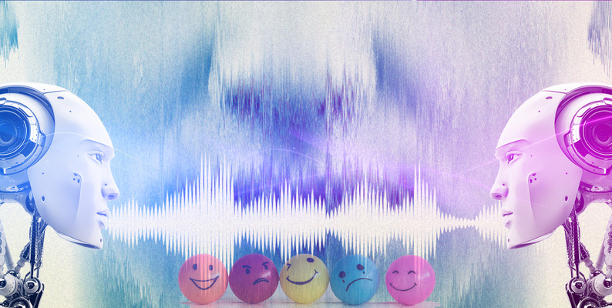
Gaps Identified
Data Scarcity and Diversity: Limited availability of large, diverse emotion-labeled speech datasets can be a significant gap. There's a need for more comprehensive and representative datasets covering various languages, cultures, and emotional contexts.
Cross-Cultural and Multilingual SER: Many existing SER models perform well for specific languages and cultures but may struggle with cross-cultural and multilingual recognition. Bridging this gap is crucial for practical applications.
Subjectivity and Variability: Emotions are subjective and can vary greatly among individuals. Recognizing and accounting for this variability in SER remains a challenge.
Long-Duration Speech: Most SER research focuses on short-duration speech samples. Recognizing emotions in longer conversations or speeches is an emerging research area.

Slide 11
Problem Statement
04

Slide 12
Problems in Existing System
Real-Time Requirements: In some applications, such as customer service or mental health monitoring, SER systems must operate in real-time. Existing systems may not meet these stringent timing requirements.
Noise Sensitivity: SER models can be sensitive to background noise and environmental factors, affecting their performance in real-world settings.
Data Limitations: Limited and unrepresentative training data can lead to biased models that perform poorly on certain demographic groups, languages, or emotional contexts.
Lack of Generalization: Many SER models struggle to generalize their predictions to new speakers, environments, or languages, limiting their real-world applicability.
Ambiguity and Mixed Emotions: Recognizing mixed or ambiguous emotions in speech is challenging for existing systems. Human emotions are often complex and may not fit neatly into predefined categories.
Subjectivity: Emotion recognition is subjective and can vary among individuals. SER systems may not account for this subjectivity, leading to discrepancies in emotion labels.

Slide 13
Proposed System
Larger and Diverse Training Data: Collect a more extensive and diverse dataset to ensure the model learns from a wide range of emotional expressions, languages, and demographics.
Real-Time Processing: Optimize the model for real-time processing by employing efficient architectures and parallel computing techniques, ensuring low latency.

Slide 14
05 Objective
Goal of the project

Slide 15
Objectives
Gather a comprehensive and diverse dataset of speech samples encompassing various emotional expressions, languages, demographics, and real-world contexts.
Explore and select the most relevant audio features, such as prosodic features, spectral features for emotion recognition.
Optimize the system for real-time processing, ensuring low latency for applications requiring instantaneous emotion recognition.

Slide 16
06 Methodology

Slide 17
Methodology
Gather a dataset containing audio samples of speech with labeled emotions
Utilize the Librosa library to extract audio features from the data.
Divide your dataset into training, validation, and test sets to evaluate model performance effectively.
Choose an appropriate machine learning model for SER. Common choices include Support Vector Machines (SVM), MLP.

Slide 18
Methodology
Train the selected machine learning model on the training data using the extracted and scaled features.
Evaluate the trained model on the test dataset to assess its performance using appropriate evaluation metrics
Once satisfied with the model's performance, deploy it for real-time or batch inference on new speech data

Slide 19
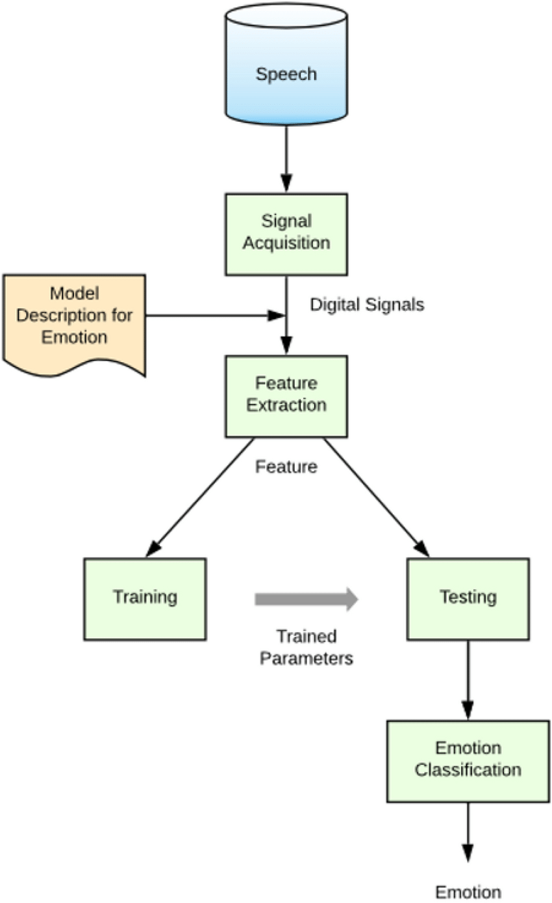
BLOCK DIAGRAM

Slide 20
07
Identifying Dataset

Slide 21
Dataset
RAVDESS (Ryerson Audio-Visual Database of Emotional Speech and Song) consists of audio recordings of actors portraying different emotions while speaking and singing. It includes a total of 8 emotional categories.
SAVEE (Surrey Audio-Visual Expressed Emotion) dataset containing emotional speech recordings from a few actors. It's suitable for initial experimentation and prototyping.
CommonVoice is Mozilla's CommonVoice dataset contains a vast collection of multilingual voice recordings. While not labeled for emotions, it can be used for transfer learning and adaptation to specific SER tasks.

Slide 22
Creating a Streamlit App for Emotion Prediction
User-Friendly Interface:
Ensure the interface is intuitive and user-friendly.
Recording Feature:
The "Record Audio" feature is a great addition. Ensure users understand the process and provide feedback during recording.
File Upload:
Allow users to upload audio files for emotion prediction.
Display the uploaded audio file for users to verify.
Emotion Prediction Display:
Display the predicted emotion prominently.
Consider using visual elements (icons, colors) to enhance the emotional impact of predictions.
Audio Visualization:
Visualize the audio waveform or spectrogram to make it more engaging.
Consider showing a visual representation of the extracted features.
Model Information:
Share information about the model, such as its training data, accuracy, and any relevant details.
Customization:
Consider adding customization options, such as selecting specific features or adjusting prediction thresholds.
Responsive Design:
Make sure the app's layout is responsive to different screen sizes.

Slide 23
08
UI IMPLEMENTATION

Slide 24
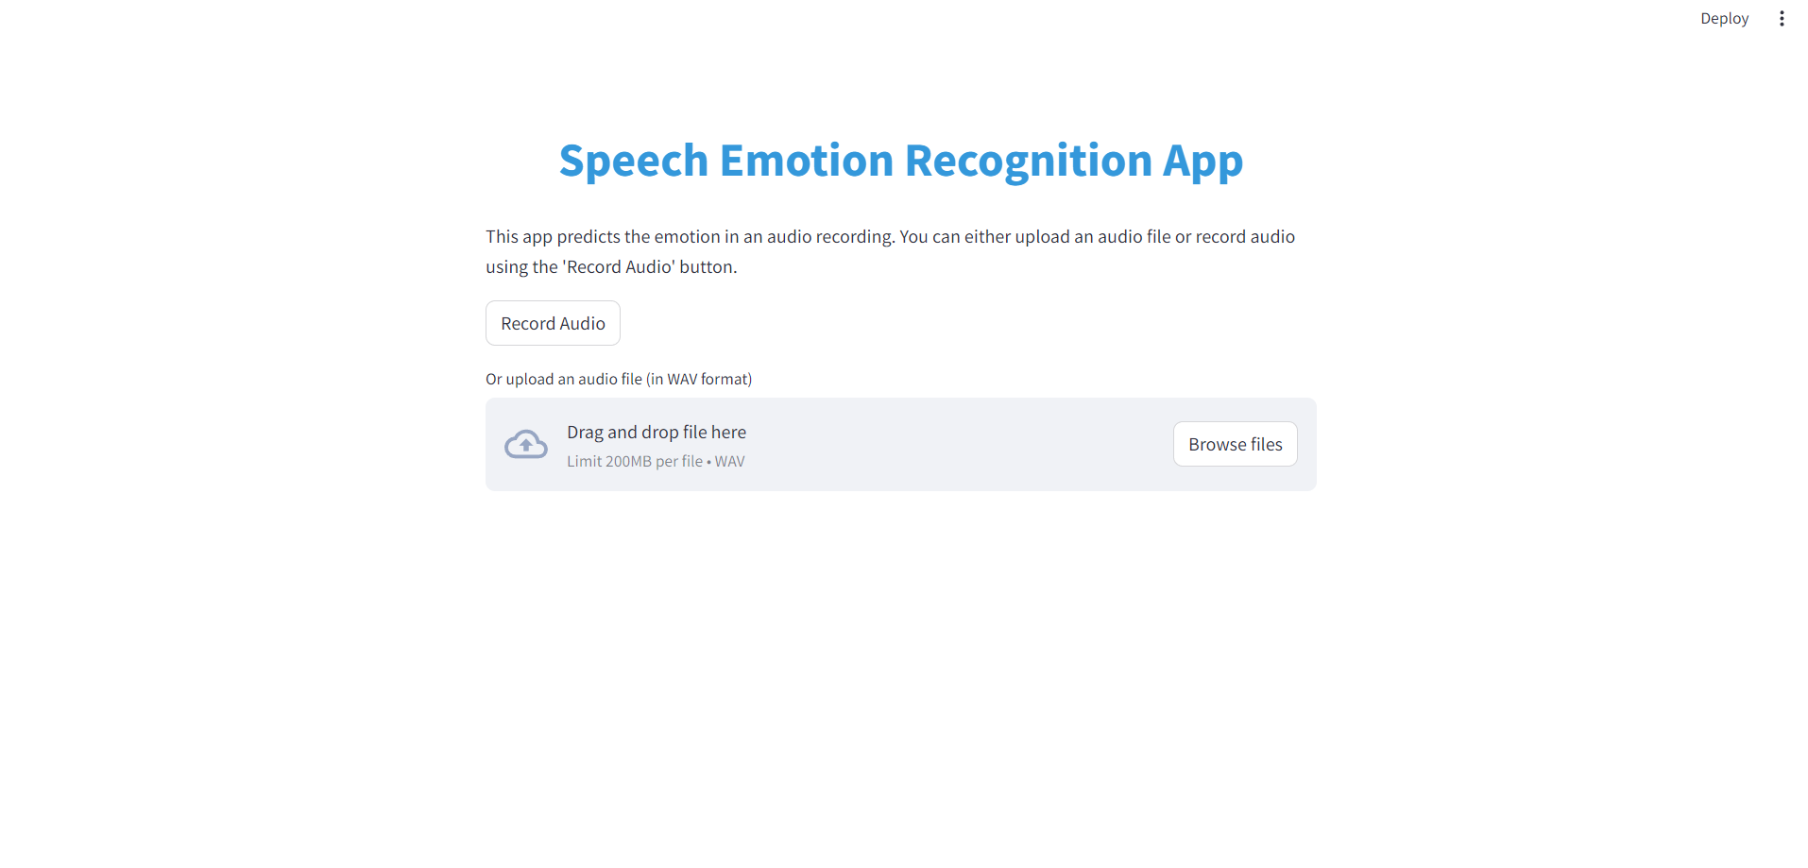

Slide 25
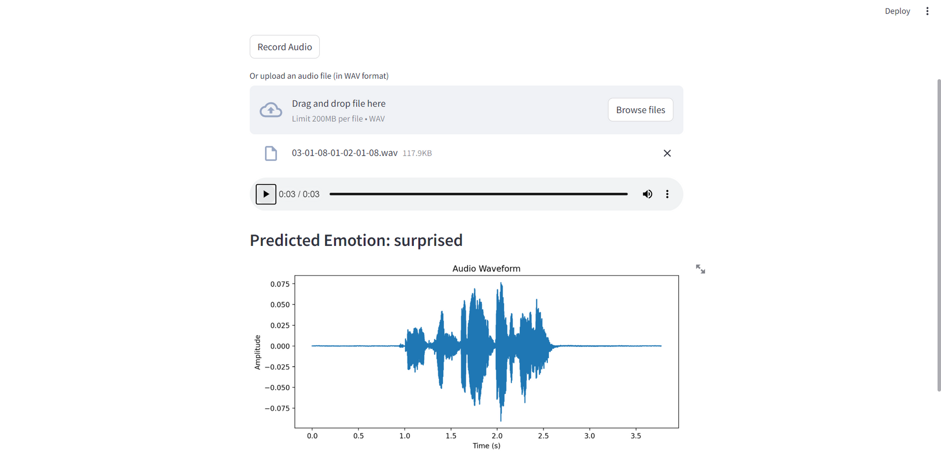

Slide 26
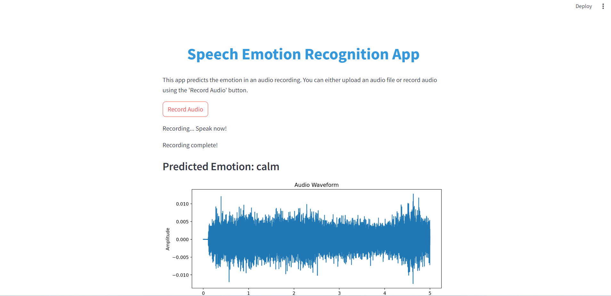

Slide 27
08
Expected Results

Slide 28
Results
Input will be a audio segment of a person speaking, expressing his emotion in speech in wav format.
Output will be the emotion present in the audio segement.

Slide 29
09
Conclusion

Slide 30
Conclusion
SER faces challenges related to data scarcity, cross-cultural recognition, handling mixed emotions, and achieving real-time processing. These challenges underscore the need for continued research and innovation in the field.
A typical SER methodology involves data collection, feature extraction, model selection, and evaluation. Machine learning techniques, often combined with deep learning and audio feature extraction libraries like Librosa, play a pivotal role in developing accurate SER systems.
As SER technology advances, ethical considerations such as privacy, consent, and potential misuse of emotional data become increasingly important. Ensuring transparent and ethical data practices is vital.
SER has a broad range of applications, from enhancing customer service interactions and mental health assessment to improving human-computer interfaces. These applications have the potential to positively impact various sectors, including healthcare, entertainment, and education.
The future of SER lies in addressing existing challenges, refining models for better generalization, and making SER systems more adaptable to various languages and cultures. Continuous improvement in ethical standards and user satisfaction is equally important.

